Slide 1
V10 Configuration
Configuring Claim History

Slide 2
Assessment Creation process
Objective
At the end of this session you will be able to :
Explain claim history functionality
Create custom claim history types
Create custom claim history records
Track individual field changes in Gosu

Slide 3
History Records

Slide 4
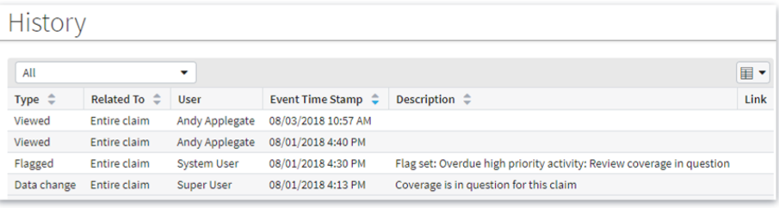
Claim History
Is an uneditable record of important events and actions taken on the claim
Includes obvious actions such as edits
Also includes more trivial events such as viewing the claim
Notes:
Because records are uneditable, the claim history acts as a legally referenceable record of who did what with respect to a given claim.
By configuring history events, the History screen can include any kind of event an insurer wants to track. For example, it can track changes to a field, including both old and new values.

Slide 5
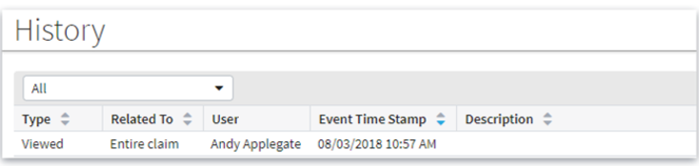
History Record
Is an entry in the claim history, documenting a single recordable claim action or event
Every history record has the following fields:
Type
Related To
User
Event Time Stamp
The following fields are optional
Description
Link
Notes:
Claim history record fields include:
Type – The claim event causing the entry in the History table, such as an exposure being opened, closed or reopened, a stopped check, an activity’s due date change and so on
Related To – Whether the event relates to the entire claim or one of its parts, like an exposure or reserve line
User – Person who caused the event
Event Time Stamp – Date and time the event occurred (in descending order, by default)
Description – A brief description of the event. This is provided for history entries written by ClaimCenter

Slide 6
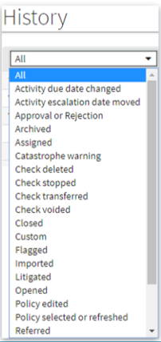
Output of Generation
Is the claim event causing the history record to be created.
Example: Closing a claim is an event which produces a history record of type “Closed”
History screen has a history type filter
Can search for history events of a particular type
ClaimCenter comes with standard history types which trigger automatically created claim history records
Standard events include editing, assigning, viewing, approvals, and so on
Some events are not included in history in the base application, such as creating activities and creating reserves
ClaimCenter may be configured to have custom history types
This defines additional events which are added to the claim history
Notes:
The base application claim history event types are defined in the HistoryType typelist. These history events will be generated by ClaimCenter by default regardless of configuration. More details on these event types can be found in the ClaimCenter Application Guide, under Claim History section.

Slide 7
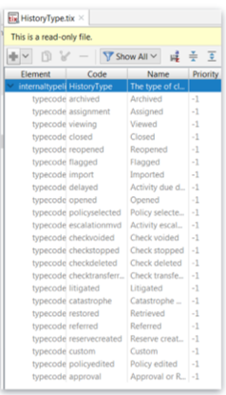
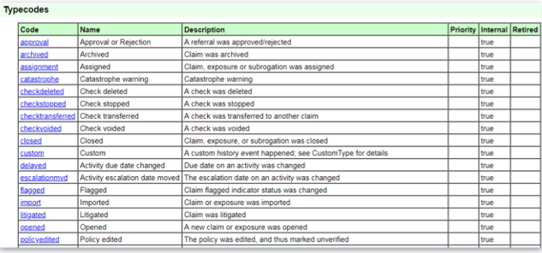
HistoryType typelist
Can be viewed in the Data Dictionary or Studio
Cannot be edited
Notes:
HistoryType cannot be edited because it is an internal typelist. However, note the type “Custom”, which enables the use of custom history types.

Slide 8
Review Question
What is a ClaimCenter claim history record?
An uneditable record of some important event or action taken on the claim.

Slide 9
Review Question
If no active rules write claim history records, will any claim history records be written?
Yes, the base history types are automatically tracked, and do not depend on rules

Slide 10
Configuring Claim History

Slide 11
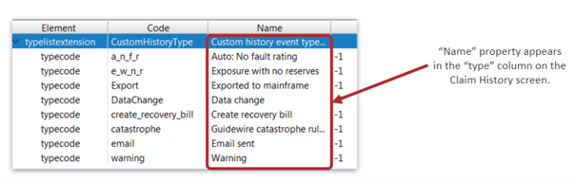
Creating Custom Claim History Types
Must be added to CustomHistoryType typelist
Defines history events that may be tracked by configured rules
Many custom history types are predefined in the base application
You can add new custom history types
Notes:
You can add new history types to the CustomHistoryType typelist and use them to create custom history events using preupdate rules
When you add a custom history event to a claim’s history, the value in the field appears as the history type.
The screenshot shows the CustomHistoryType typelist as it appears in the base application

Slide 12
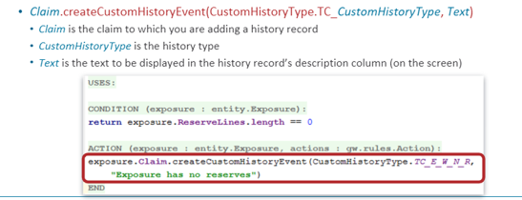
Recording Custom History Events
Create a preupdate rule that captures the history condition
The action uses the createCustomHistoryEvent() method on Claim
Syntax:
Notes:
If the screenshot, we use the base application’s “exposure with no reserves” custom history type to create a history record when an exposure with no reserves is created or updated

Slide 13

Testing fields for changes
Use the isFieldChanged() method
Syntax
Entity.iusFieldChanged(entity#field) or entity.isFieldChanged(field)
Returns boolean
Notes:
You can find out whether a field has changed using the isFieldChanged() method. This is useful for setting the condition on a preupdate rule.

Slide 14
Finding original field values
To determine the original value of a changed field, use the getOriginalValue() method
Syntax:
etnity. getOriginalValue(entity#field) or entity.getOriginalValue(field)
Returns an ordinary object
Need to cast the result in order to get the display name
Notes:
You can find the original value for a changed field using the getOriginalValue() method. This is useful both for conditions and for setting the description field of a claim history entry.

Slide 15
Review Question
Is it possible to define new types of history events?
Yes, by adding them to the CustomHistoryType typelist and creating rules to record them

Slide 16
Thank you

